Slide 1
I - Presentation of the Special Economic Zones

Slide 2
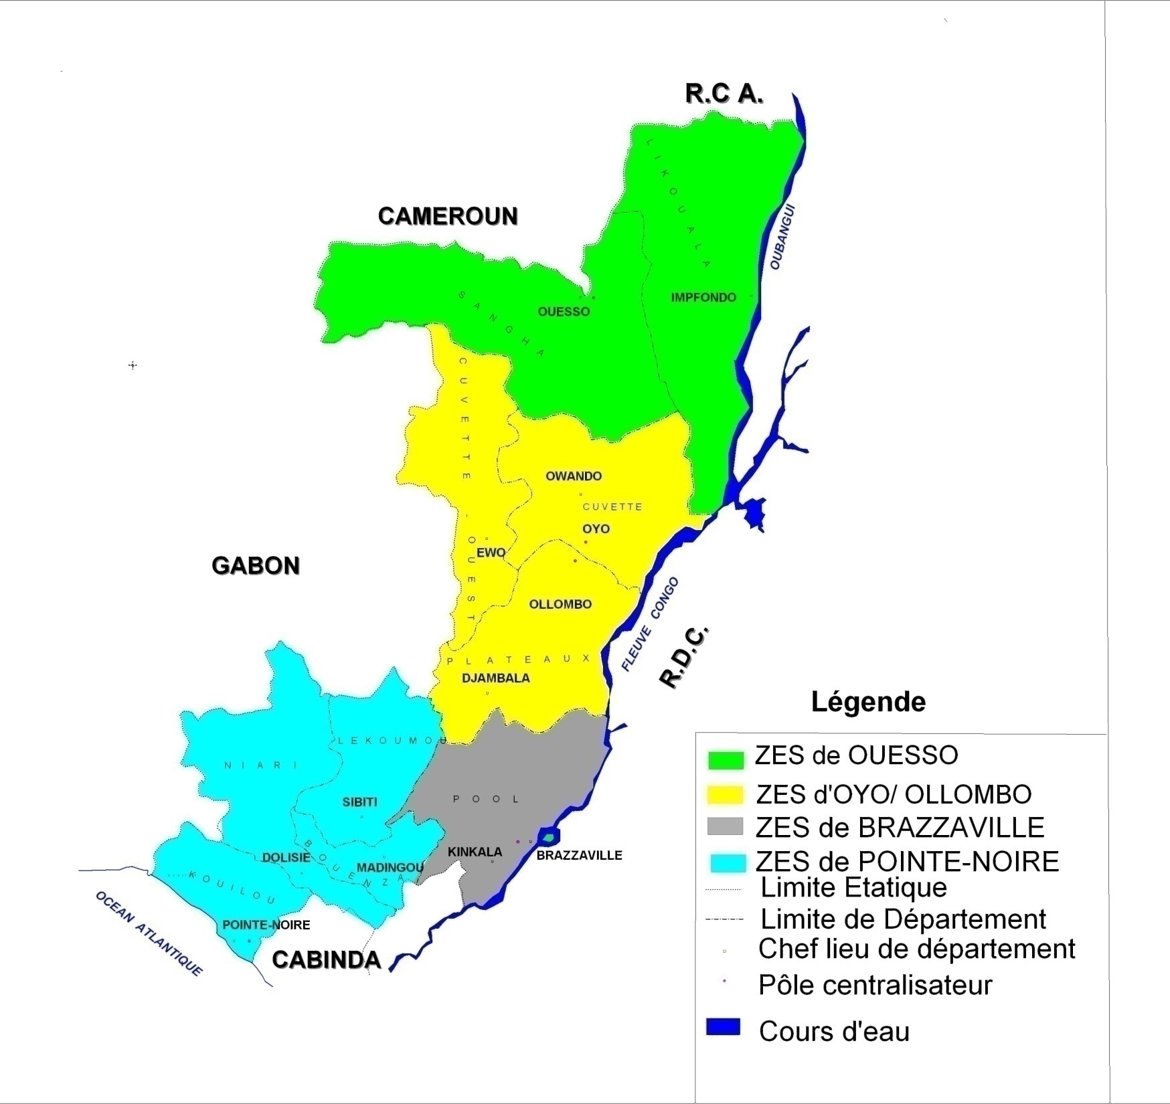

Slide 3
« Special Economic Zone » means a geographical space limited within the territory of the Republic of Congo, being a priority development zone, administered by a specific body of planning and development.

Slide 4
Part I
Special Economic Zone of Ouesso

Slide 5
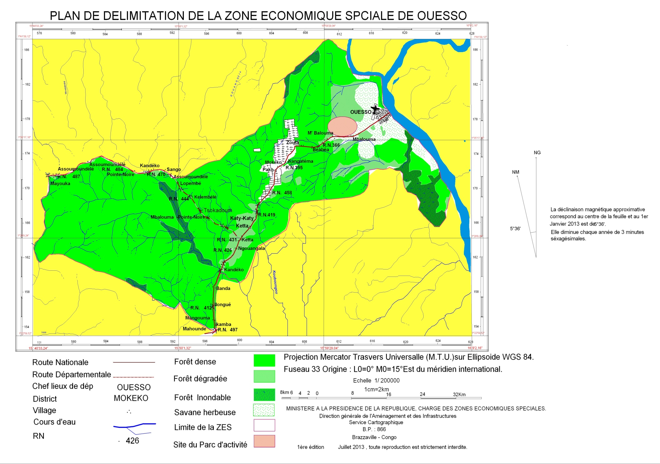

Slide 6
The Special Economic Zone of Ouesso covers a surface area of 64,520 hectares.

Slide 7
Activities adopted

Slide 8
The first Phase is centered on the industrial processing of timber in sawmill and plywood, and in the long term, the production of furniture and the real estate constructions; The second Phase is centered on the preparation, the development of crops of coffee and cocoa and the creation of the agribusiness through the processing of these crops; The third Phase concerns the crops of the palm groves;

Slide 9
Jobs Creation

Slide 10
The SEZ of Ouesso being mainlybased in Phase 1 over Free trade areas ,Ouesso and the neighboring cities will benefit from the settlement of new civil servants booked for the SEZ( staff of the all in one office ,regional delegation of the planning agency etc.) and, quickly, for the increasing of the industrial activity related to timber.
.

Slide 11
Investments

Slide 12
Costs
Investments : construction of an administrative modern block in Ouesso to host the ~25 civil servants of the planning agency and their adjoining services (if there is no building available), cost estimated to 1,2 bn of CFAF (1,8 M€) ;
Costs of management (staff, maintenance, travelling, etc.) : in first estimates, costs of management assessed to ~130 M of CFAF (200.000 €) a year , on the average, until 2020.

Slide 13
Impact on the GDP

Slide 14
Profits from the SEZ of Ouesso
GDP : potential GDP of ~350 M$ US in 2020, generated mainly from the timber industry from the north of the country and higher than 700 M$ US by 2030, related to the increase of the timber processing and the emergence of the coffee and cocoa industry (under the reservation of the efforts from the research on the income generating crops neglected today).

Slide 15
Prospective Impact of the SEZ of Ouesso
Potential of additional GDP
Comments
GDP generated by the SEZ of Ouesso, in M$
Timber Industry
Progressive rise of the processed production related to thebinstauration of free area :
- Attractive taxation inciting the industrials to investin the capacities
of processing;
- Reinforcement of the legislationand the means of control limiting
the export of the processed production;
Progressive rise of the average selling price thanks to the double effect of the rise of rate of the processing and the rise in scale of the rpocessed products :
- Today : less than 20% of local processing;
- In 2020 : 30% gross, 60% sawmill, 10% plywood;
- In 2030 : 20% brut, 60% sciages, 20% placages.
Additional GDP generated in case of the construction of a road of export
Ouesso – Djambala – Pointe‐Noire (expected by the industrials since it would enable to save ~70$/m³ transport costs ):
- More than 60 M$ of direct additional GDP in 2020, away from the GDP from the construction of the road;
- ~650M$ of an investment for the achievement of the road
(estimate);
- Profitability of the road for the State in~10 years , thanks to an additional GDP related to the transport of timber between Ouesso and Pointe‐Noire by the Congolese enterprises (vs. Cameroonian currently)
Coffee and cocoa
- Rise of the selling price of the bag of coffee and cocoa by 4%
a year
- Coffee: 10% of the rise of volume per year in line with the rise of small producers having been able to increase their production (from
1991 to 2000, +17% p.a. for Liberia, +8% p.a. for Ghana,
+7% p.a. for Sierra Leone)
- Cocoa: impossibility to industrialize the field limiting the growth in
volume to 10% per year, 95% of the production being done by small farmers in the farms from 2 to 5 hectares
GDP of the industry of tmber (Forests of the North only) with export by the Cameroon
Additional GDP of the industry of timber
with exports by the road Ouesso –
Djambala – Pointe‐Noire
725
PIB de l’industrie du café
PIB de l’industrie du cacao
 | 348
 | 64
 | 265
68
68
2013 2020
95
13
557
2030
Hypotheses/predictions:
Increase of the processed timber production share of ~20% currently to 70% in 2020 and 80% in 2030
Correlative increase of the average selling timber price of ~100$/m³ currently to à 350$/m³ in 2020 and ~740$/m³ in 2030
Moderated rise of exports timber of ~630 thousand _{m}3 _{c} 760 in 2020, and maintained until 2030
Progressive rise of the production of coffee and of cocoa to a rythm of 10% per year from 2020

Slide 16
Part II
Special Economic Zone of Brazzaville

Slide 17
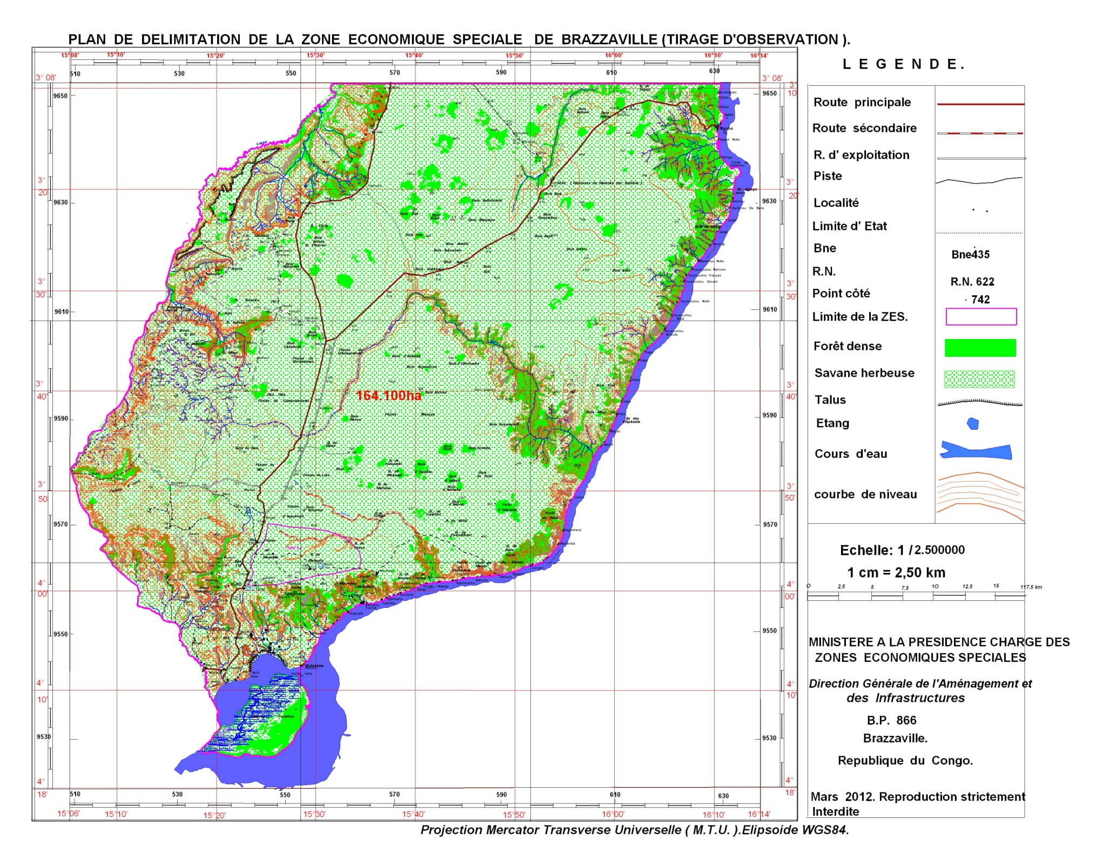

Slide 18
The Special Economic Zone of Brazzaville covers a surface area of 164,100 hectares.

Slide 19
Activities adopted

Slide 20
The first Phase is centered on :
- the revitalization of the palm grove (processing of the palm oil, in edible oil and soap);
- gardening (flowers,fruits and vegetables)
- building materials (cement, rubble, bricks/ tiles)
- the logistics (transport, packaging, stocking, etc.) ;
The second Phase is centered on:
- The renewable energies with the production of bio ethanol
from the sugar cane and the biodiesel from palm oil ;

Slide 21
Jobs Creation

Slide 22
Potential jobs to create:
- 21.000 jobs by2020 (6.000 in Brazzaville and 15.000 in the plantations catering the SEZ)
- 43.000 jobs by 2030 (23.000 in Brazzaville, 20.000 in the plantations), equals to more than the double of the current formal private sector.

Slide 23
Investments

Slide 24
Costs
The initial investments to be taken in charge for the industrial park of Brazzaville are estimated to 234 bn of CFAF (350 M€) over 4 years, namely :
- 58 bn of CFAF for the development of the park of 622 hectares and the construction of 8 administrative buildings ;
- 55 bn of CFAF to put in place the network at the international standards (pumping and water treatment and the connection to the national electric network);
- 120 bn of CFAF for the construction of a block of 6.000 accommodations expected to host the first 6.000 employees of the site and their families by 2020 (a total of 30.000 persons living in and around the SEZ);
- The Developer will generate also operational costs for the administrative services, the maintenance of networks and the water and power supply estimated to 13 bn of CFAF per year, on the average, between 2014 and 2030. These costs will partially be covered by the outcome related to the billing of services to the investors.

Slide 25
Impact on the GDP

Slide 26
Potential GDP to generate
0.7 bn$ US of direct GDP by 2020;
1.7 bn$ US by2030 (either ~40% of the current non oil GDP)

Slide 27
Impact on the growth of the urban population

Slide 28
Population :
- 30.000 inhabitants by2020;
- 115.000 inhabitants by 2030 in adding the effects derived from the SEZ (services to the populations and to the enterprises, sub –contracting…) the demographic impact could be doubled and could result in the creation of a city of 250.000 inhabitants in the SEZ of Brazzaville.

Slide 29
Part III
Special Economic Zone of Oyo/Ollombo

Slide 30
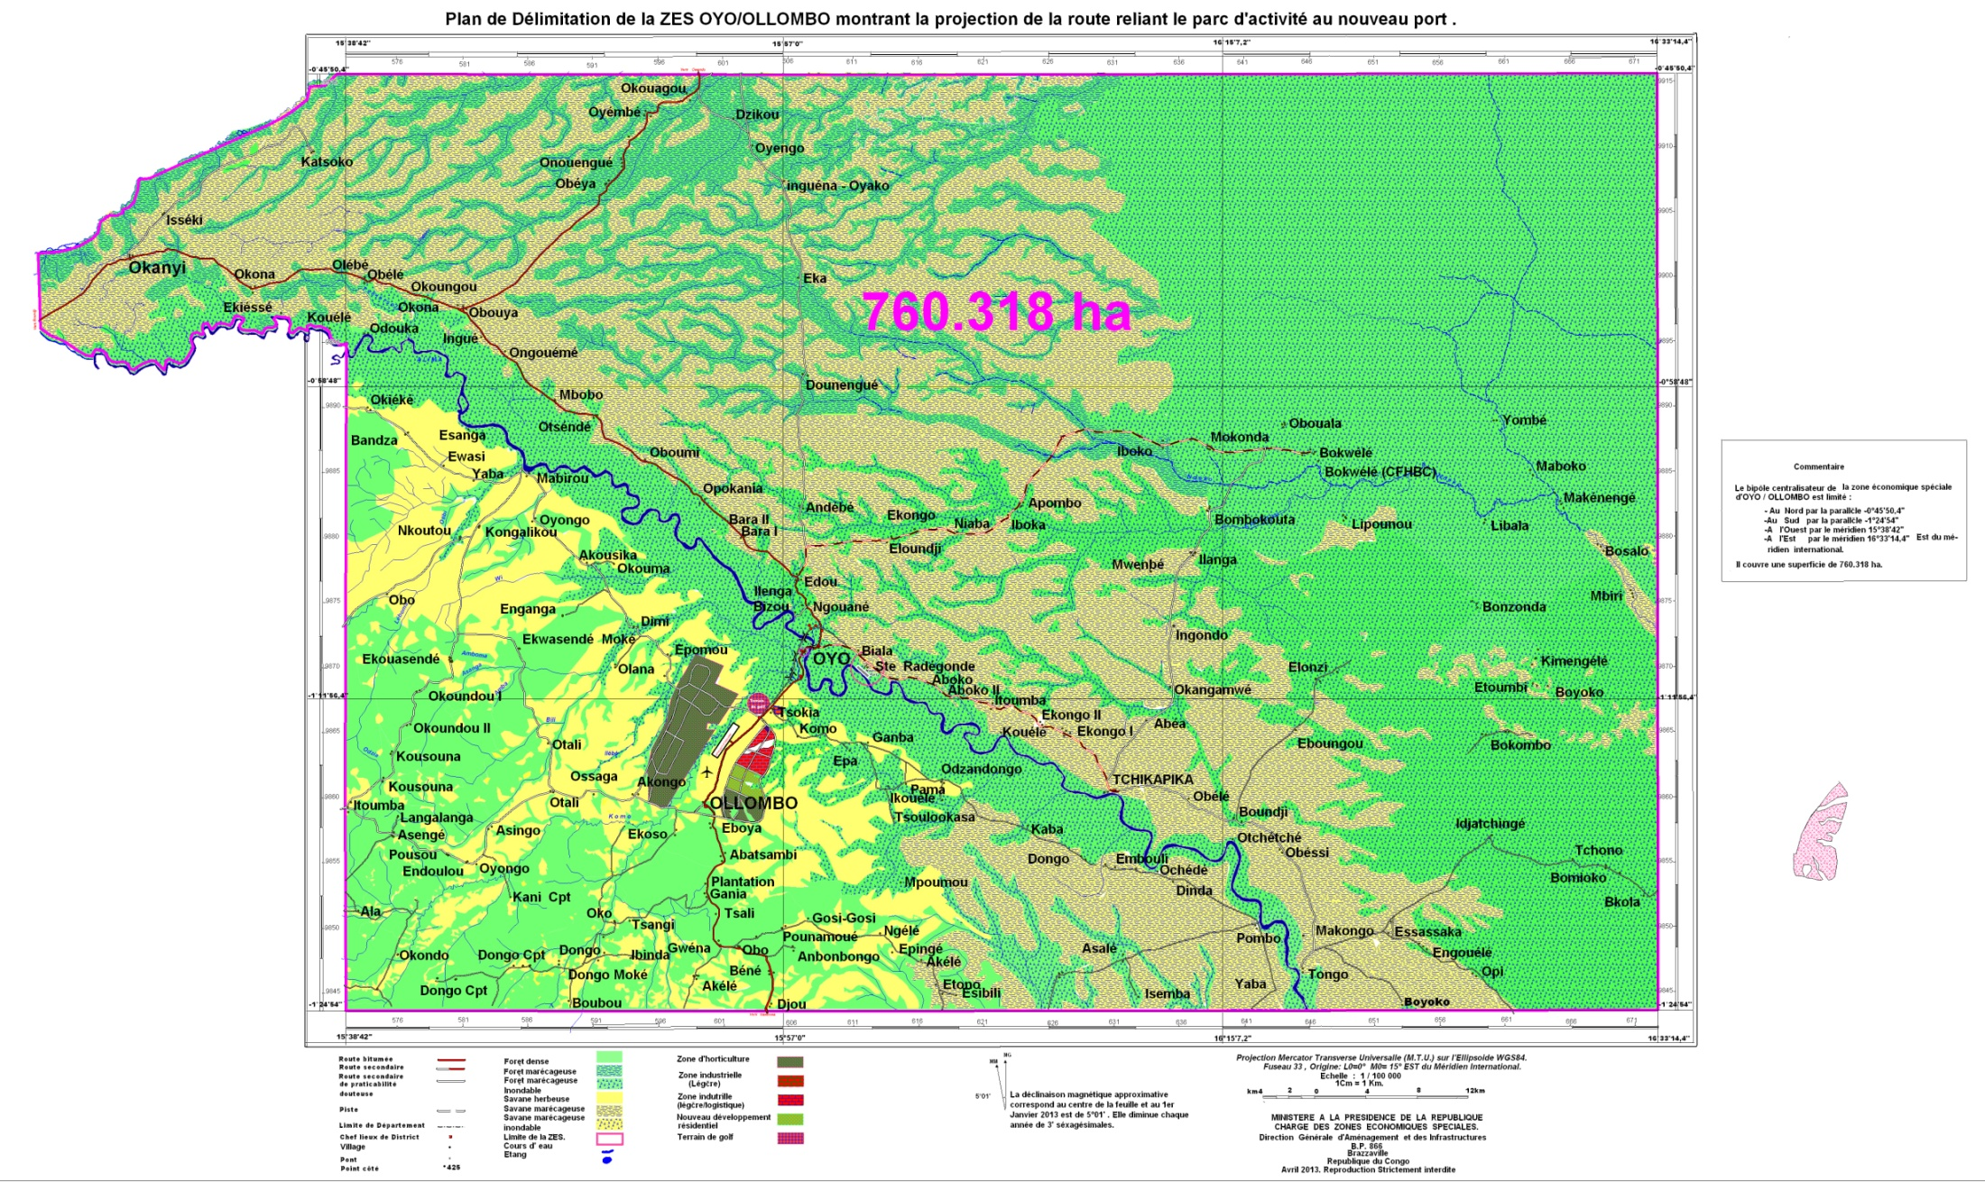

Slide 31
The Special Economic Zone of Oyo/Ollombo covers a surface area of 760,318 hectares.

Slide 32
Activities adopted

Slide 33
- Production and revenue of food crops;
- Farming of livestock;
- Processing of agricultural products (edible categories) - Processing of agricultural products (non edible categories)
- Forestry;
- Fish farming
- Commercial Services;
- Tourism.

Slide 34
Jobs Creation

Slide 35
We estimate to 120.000, the number of jobs to create by 2032,
Either ,on the average, 6500 jobs generated per year.

Slide 36
Investments

Slide 37
The Cost of the investments for the construction of the first phase of infrastructures of the SEZ is evaluated to the amount of 234.030.655 US$ and concerns among other things :
- the excavations;
- the roads;
- the upgrading of the water treatment unit in the City of Oyo;
- the drainage of rain waters;
- the sanitation etc. ...

Slide 38
Impact on the GDP

Slide 39
The GDP is evaluated to the tune of 1,528 billion of US $ by 2032.

Slide 40
Impact on the population growth

Slide 41
Estimates of the population | Phase 1 (1 – 5 years ) | Phase 4 (16 – 20 years)
Resident Population estimated on the basis of the natural growth rate | 45.566 | 67.359
Migrant Population | 52.677 | 243.493
Casual workers | 31.911 | 3.986
Total Population | 130.154 | 314.838

Slide 42
Part IV
Special Economic Zone of Pointe-Noire

Slide 43
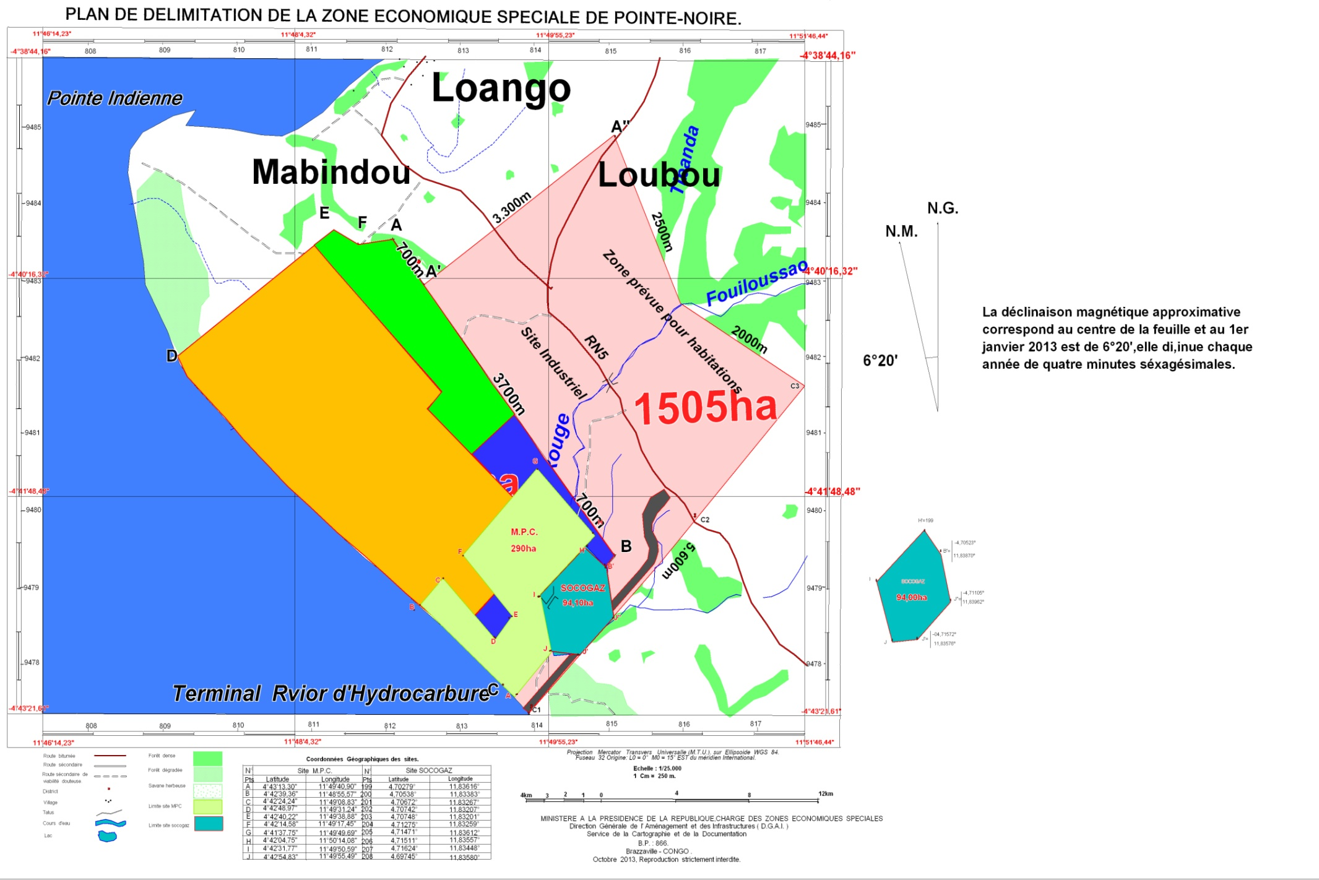

Slide 44
The Special Economic Zone of Pointe-Noire covers a surface area of 3150 hectares.

Slide 45
The feasability studies of the Special Economic Zone of Pointe-Noire, carried out by the Singaporean JURONG firm are still pending.
However, the market research proposes the following activities:

Slide 46
Activities adopted

Slide 47
The refined oil products ;
the metals and the engineering;
the chemical products ;
the food industry and the beverages ;
the non metallic mineral products ;
the timber and the wood derived products;
the paper and the paper products (stationery);
the production of plastic products and glass items;
the printing house and the edition;
the repair and the installation of machinery and equipments;
the services related to the activities quoted above;
the tourism.

Slide 48
II - GOVERNANCE

Slide 49
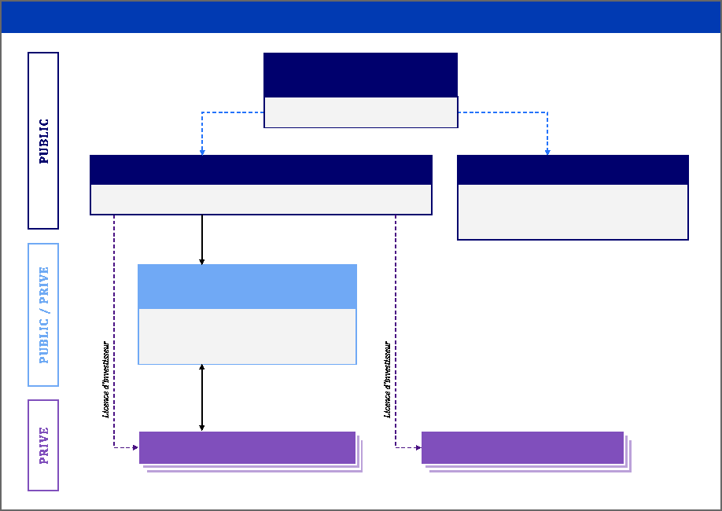
Chart of the governance of the SEZ in the Republic of Congo
Presidency of the Republic
Creation of the SEZ
General Coordination
Trusteeship via the Ministtry to the Présidency in charge of SEZ
Appoints the Président of a Council of 4 independent members
National Agency of planning the SEZ(EPIC)
National Authority of the regulation (EPA)
Planining / Development ‒ public and external infrastructures
Agreeement of Investiors ‒ All in one office
- Independent Authority
- Regulation (respect of the rules of the SEZ)
- Settlements of conflits between the planner, the Developers) and the Investorss
Contract of the development /Conditions specified
Developer of a Park of Activités (e.g. Brazzaville)
- Financing and mastery of work
Viabilisation of the national Park-
-internal infrastructures
- industrial et residentiel real estate
Contracts of services
Investors in Activity Park
Investors in Free Area

Slide 50
The bodies of the SEZ Governance

Slide 51
I – Planning Agency

Slide 52
Missions :
‒ Planning and development of SEZ (master plans, large arbitration of development and town planning etc.) ;
‒ Management of public infrastructures and external to the SEZ (planning and coordination with the State) ;
‒ Agreement of Investors (validation of industrial projects and
control of financial and operational capacities of the applicants) ;
‒ All in one office ( specific administration to SEZ ).

Slide 53
II – Regulation of the SEZ

Slide 54
Mission :
‒About the conflicts settlement and rules enforcement in the SEZ ;
‒ About the memoranda on the good customs and practices in the SEZ;
‒ About the control of the services delivery prices proposed to the investors.

Slide 55
III - Developer

Slide 56
Mission :
‒ To finance and to achieve the works of SEZ : internal infrastructures , developing building sites, industrial and residential buildings;
‒ To propose quality services to Investors (electricity, water, accommodations, etc.).

Slide 57
III - LEGAL FRAMEWORK

Slide 58
A law which institutes the regime of the Special Economic Zone will soon be submitted under consideration by both Parliament chambers through the Cabinet’s Meeting.
It devotes the fiscal, customs and social advantages to the investors.

Slide 59
IV - DEVELOPMENT OF THE INFRASTRUCTURES OF THE SPECIAL ECONOMIC ZONE OF OYO/OLLOMBO

Slide 60
The development of the infrastructures plays an important role in supporting the economic activities of a city. The establishment of a strong base for the infrastructures and a good network helps in the positioning of the SEZ as a well designed profitable investment destination, endowed with an export area , with a good and well related service, to the sub-regional and global market.

Slide 61
Land Acquisition for the first Phase of Development.

Slide 62
It will be in use for the construction :
of an administartive Center;
of the mixed use resident sector, the downtown area and the Cultural Center;
of the light Industrial Zone;
 of the General and heavy Industrial Zone;
 of the River Port;
 of a University, School and Training institutions;
 of the Residential Area ( including a Golf area and a zone of houses).

Slide 63
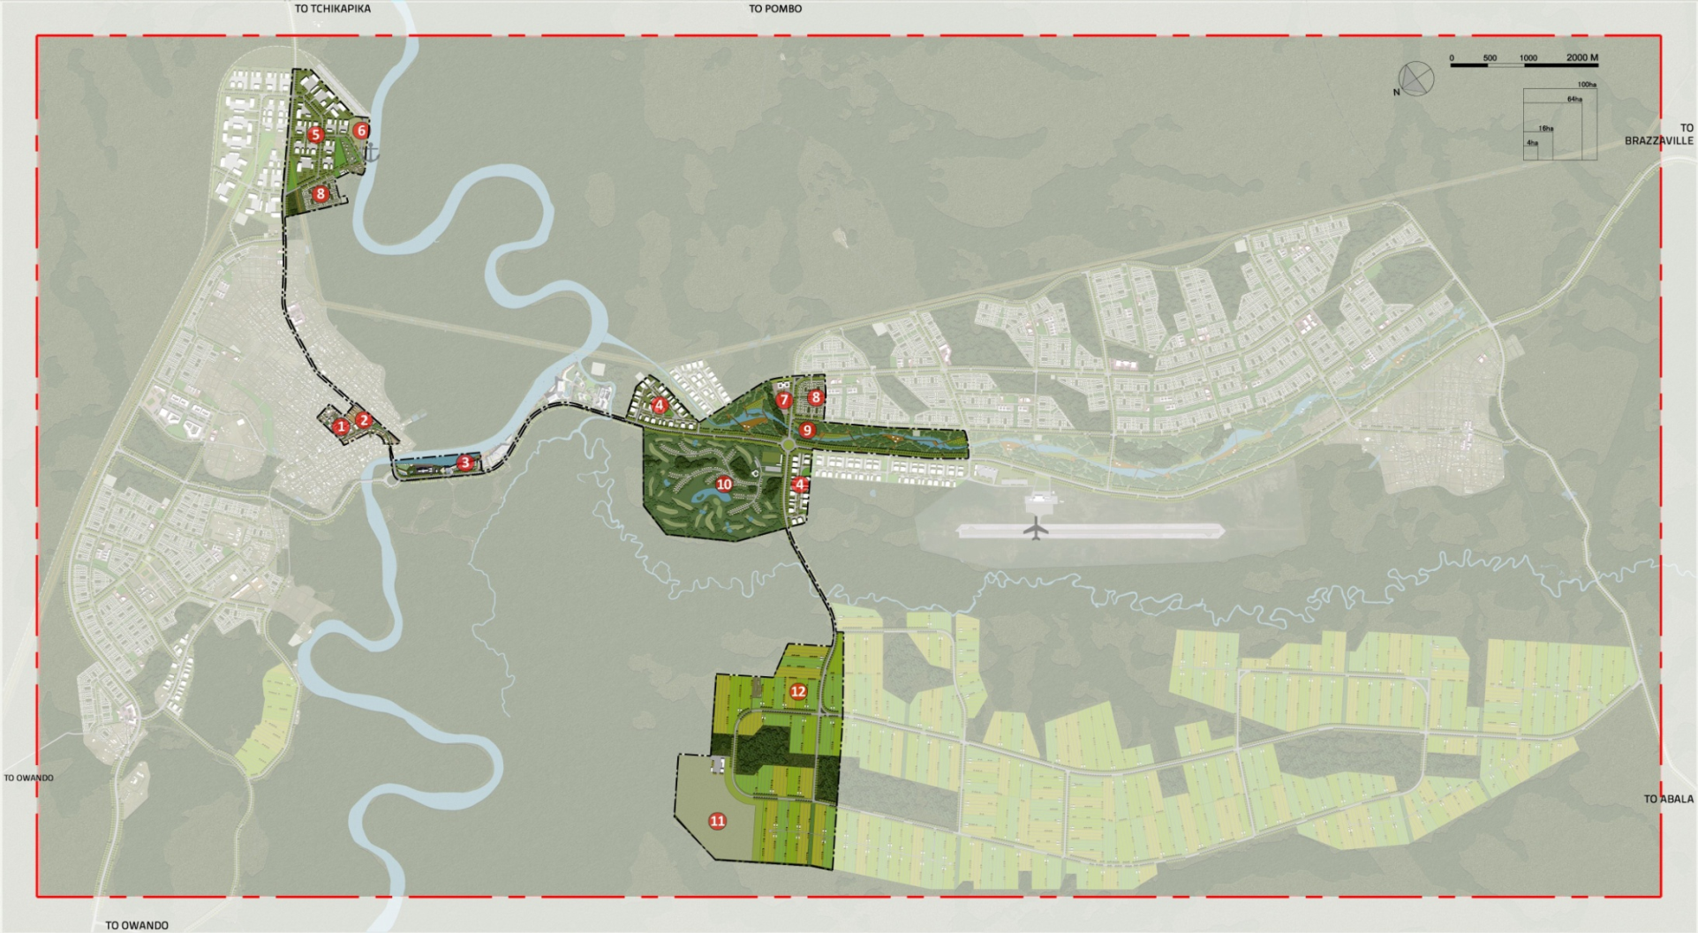
4. Light Industrial Zone
5. General and heavy Industrial Zone
6. River Port
7. University, School and Training Institutions
8. New Residential Development
9. Park of the Town
10.Golf Area and Houses
11. Rubbish Dumping
12. Horticulture
1. Administrative Center;
2. Town Hall of Oyo
3. Mixed Use Resident Sector,
Down Town;, Cultural Center

Slide 64
Infrastructures for the
Phase 1

Slide 65
Works of Excavation

Slide 66
One needs to take away a layer of vegetal land of about 2m thick, then to replace it by some sand or the good land with 2.5m of more land to be at the same level with the existing road.
(see the picture below)

Slide 67
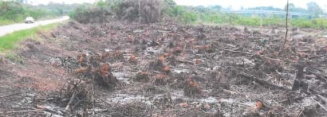
Picture 2 : Current conditions of the soil close to the River Alima

Slide 68
Roads

Slide 69
The program of roads construction mainly forsees to supply ways of access to the new developments inside the SEZ.
The National Road 2 will always remain the main road for the traffic from the SEZ towards various cities.

Slide 70
3. Water Catering

Slide 71
It concerns the modernization of the current water treatment unit of the City of Oyo, with the construction of 3 water towers and 25km of main gully.

Slide 72
4. Drainage of Rain waters

Slide 73
One needs to build drainpipes aimed at evacuating the rain waters in the river Alima, through a canal 10km long.

Slide 74
5. Sanitation

Slide 75
Two purification stations of used waters are planned for the first Phase of development. One of them will be located on the south bank of the river Alima in order to serve the industrial and residential developments expected.

Slide 76
6. Management of Solid Wastes

Slide 77
The integrated management factory of solid wastes includes a center of recuperation, a center of composting and of the biomass management for the processing of organic wastes,as well as a site of a technical burying.

Slide 78
7. Power supply

Slide 79
The power supply consists in building a sub – station of 110kV/20kV in order to distribute power to new developments.

Slide 80
Estimate of costs for the first phase of the development of infrastructures

Slide 81
No. | Infrastructures | Description of Works | Cost (XAF) | Cost (USD)
1 | Roads | Construction of 88 km of road network | FCFA 13.627.680.000 | $ 25.520.000
2 | Water catering | Modernization of the current water treatment unit, with 3 ground reservoirs and 3 water towers, 25km of main gully | FCFA 11.300.000.000 | $ 21.161.049
3 | Sanitation | Construction 2 STP (epuration station) and 14 km of main sewer | FCFA 5.400.360.000 | $ 10.113.034
4 | Drainage | Construction of 20 km of drainpipes of emptying | FCFA 2.704.376.250 | $ 5.064.375
5 | Solid Wastes | Construction of 1 composting centre 1 rubbish dump and1 Centre of Recuperation of Materials | FCFA 11.172.582.960 | $ 20.922.440
6 | Power Supply | Construction 2 sub- stations of 110/20kV and their connection to the current transmission line; construction of local sub ‐ stations (20kV/400V); connection to the new sub‐ stations110/20kV- Road Signs | FCFA 13.627.680.000 | $ 25.520.000
 |  | Total cost of the Infrastructures for the Phase 1 | FCFA 59.278.701.710 | $ 111.008.805

Slide 82
THE END.

